Slide 1

High-speed Networks, Cybersecurity, and Software-defined Networking Workshop
Jorge Crichigno, Elie Kfoury
University of South Carolina
Western Academy Support and Training Center (WASTC)
2020 Summer Conference
June 15 – June 19
National Science Foundation (NSF), Office of Advanced Cyberinfrastructure (OAC) and
Advanced Technological Education (ATE)

Slide 2
Lab 5: Setting WAN Bandwidth with
Token Bucket Filter (TBF)

Slide 3
Token Bucket Filter

Slide 4
Introduction to Token Bucket Algorithm
When emulating networks, it is sometimes necessary to set the bandwidth of devices
By manipulating the bandwidth / capacity of a link, the network behavior under different conditions can be observed
J. Kurose, K. Ross, Computer Networking: A Top-Down Approach, 7th Edition, Pearson, 2017

Slide 5
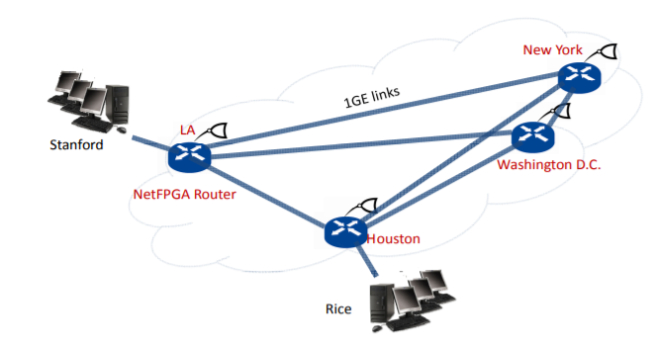
Introduction to Token Bucket Algorithm
Example: what is the ideal buffer size in a router, so that the utilization of a bottleneck link is maximized?
2009 Hardware experiment
N. Beheshti, “Tiny Buffers for Electronic and Optical Routers,” 2009. Online” https://tinyurl.com/y8uug534

Slide 6
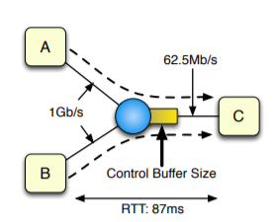
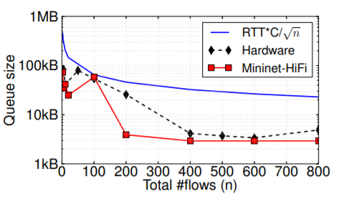
Introduction to Token Bucket Algorithm
Example: what is the ideal buffer size in a router, so that the utilization of a bottleneck link is maximized?
Red: Mininet results (2012, after Mininet was created)
Black: Internet2 backbone results (Los Angeles – Houston)
Blue: Theoretical upper bound
2009 Hardware experiment
2012 Mininet Experiment
N. Beheshti, “Tiny Buffers for Electronic and Optical Routers,” 2009. Online” https://tinyurl.com/y8uug534
Nikhil Handigo et al., “Reproducible Network Experiments Using Container-Based Emulation,” 2012. Online: https://tinyurl.com/ybeebb4v
Reproducing Network Research Website. Online: https://reproducingnetworkresearch.wordpress.com/

Slide 7
Introduction to Token Bucket Algorithm
The Token Bucket algorithm is used to limit the average rate (bps) and burst size of packets (or bits/bytes) on a link
Average rate gives the bps at which a traffic can be sent into the link
Burst size gives the maximum bps (the “burst”) that can be sent into the link over an extremely short interval of time

Slide 8
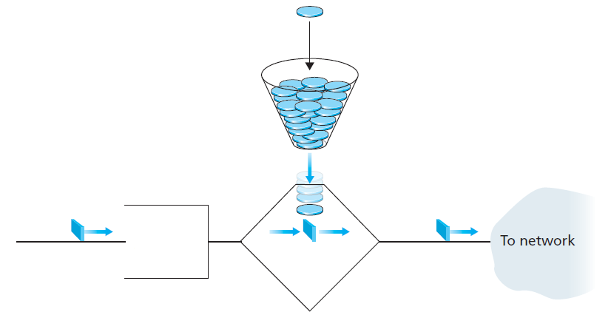
Introduction to Token Bucket Algorithm
The Token Bucket algorithm is used to limit the average rate (bps) and burst size of packets (or bits/bytes) on a link
R tokens are generated at a constant rate
A leaky bucket holds up to B tokens
A packet is sent to the network only if a token is available; one token is then removed from the bucket
If no token is available, the packet must wait in the buffer, until a token is available
R tokens per second (rate)
Bucket holds up to B tokens (burst)
Wait area
or buffer
(limit)
Arriving packet
Remove token
Departing packet

Slide 9
Rate Limit on Switches

Slide 10
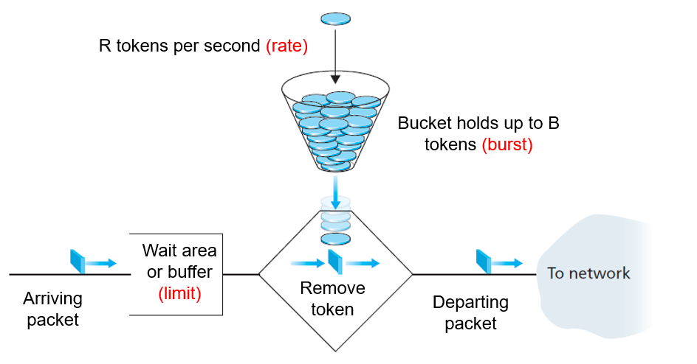
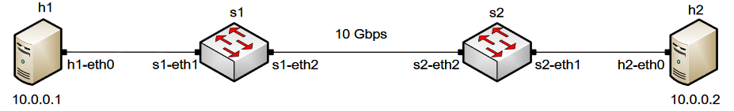
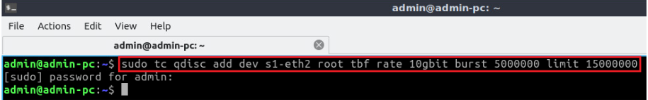
Rate Limiting on Switches
The first figure shows the network topology
The tbf parameters are the following:
rate: 10gbit (in bits per seconds)
burst: 5,000,000 (in bytes)
limit: 15,000,000 (in bytes)
Reference

Slide 11
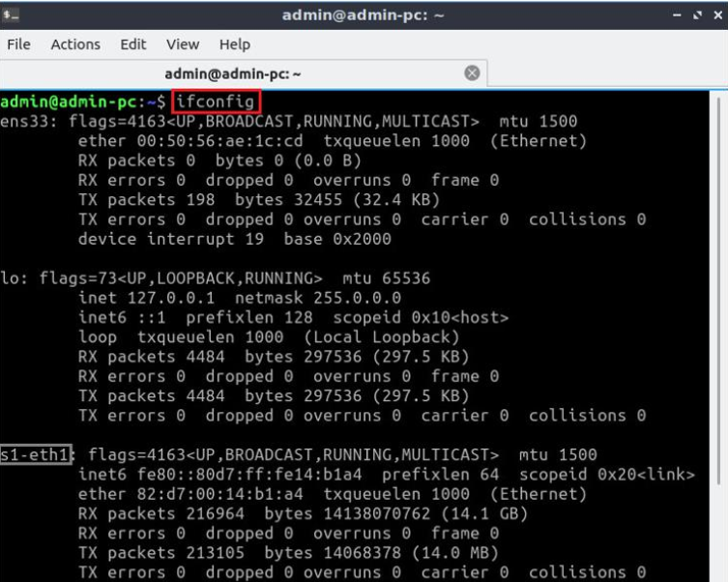
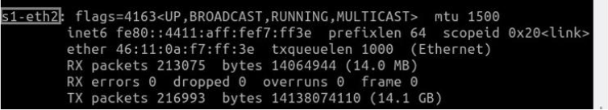
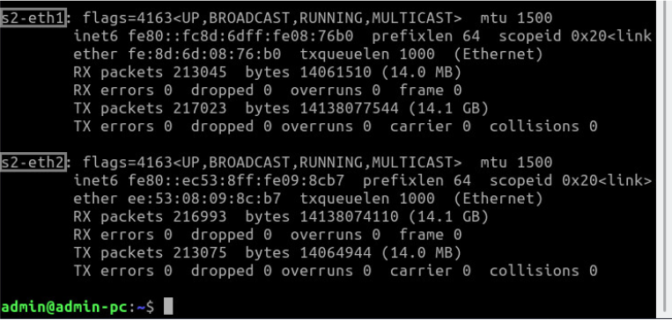
Identify Switch Interfaces
The ifconfig command is used to display information related to network interfaces

Slide 12
Rate Limit on End Devices

Slide 13
Rate Limiting on End-hosts
Reference
The first figure shows the network topology
The tbf parameters are the following:
rate: 10gbit (in bits per seconds)
burst: 5,000,000 (in bytes)
limit: 15,000,000 (in bytes)

Slide 14
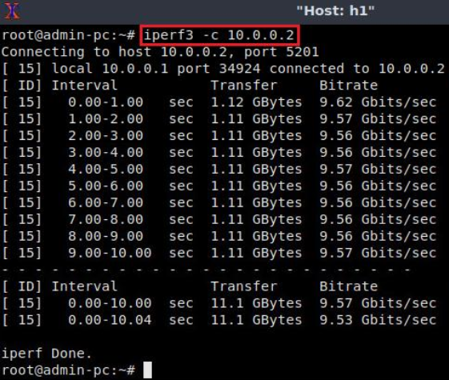
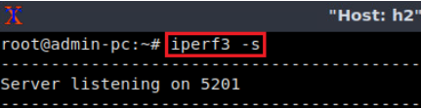
Verification
The user can now verify the previous configuration by using the iperf3tool to measure throughput
Server (h2)
Client (h1)

Slide 15
Combining NETEM and TBF

Slide 16
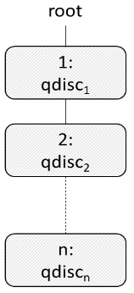
Combining Qdiscs
The first qdisc (qdisc1) is attached to the root label
Then, subsequent qdiscs can be attached to their parents by specifying the correct label

Slide 17
Combining NETEM and TBF
NETEM is used to introduce delay, jitter, packet corruption, etc.
TBF is used to limit the rate
We can combine multiple queueing disciplines (‘link features’) and activate them at the same time

Slide 18
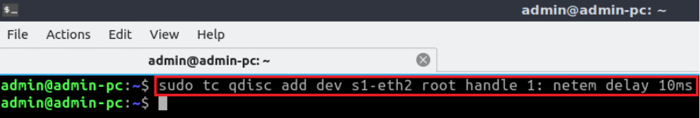
Combining NETEM and TBF
The command below activates NETEM on interface s1-eth2 to emulate delay
The new keyword in this command is handle and its value reflects the number shown above each qdisc in the figure on the right
This means that our NETEM qdisc is attached to the root with the handle1
2Gbps, 10ms

Slide 19
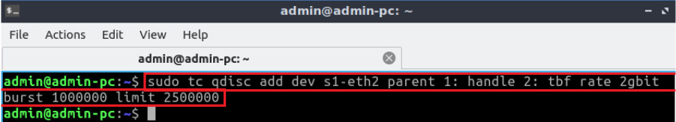
Combining NETEM and TBF
Now this command adds the second rule which applies rate limiting using tbf
The new keyword in this command is parent and its value reflects the number of the parent qdisc
The tbf qdisc is attached to the NETEM qdisc (configured in the previous slide)
TBF has a handle 2: if we decide to attach further qdiscs
2Gbps, 10ms

